Slide 1
Wikipingdia
Bryan Bingham, Nick DeWitt, Nadine Perez, Paul Pietsch

Slide 2
Issues Wikipingdia wants to address
Class pre/co-reqs have frequent disparities between information sources
Issues with the group advising sessions
Classes are so new that there’s limited feedback from students or professors
Description of undergraduate program to potential students is too broad
The infosci listserv can be overwhelming

Slide 3

Screenshot from iSchool Prerequisite List
vs.
Screenshot from Testudo schedule of classes

Slide 4
What Wikipingdia provides
Information science department news & social media
Wiki-generated class profiles with more in depth information about content of the class
iSchool approved departmental informational pages with up-to date information regarding things like co and prerequisites
Teacher profiles with extended information from teachers and student reviews

Slide 5
Technology Used
Javascript with bootstrap library
Ease of use
Multi-platform
PHP with Codeigniter Web Framework
Built in input validation
Protection against attacks like SQL injection
Used in many UMD dynamic web applications

Slide 6
Dynamic elements
We wanted for Wikipingdia to include dynamic elements along with a wiki element in addition to the static departmental information you can find on the iSchool website
Class and teacher pages can be dynamically created and populated from our sql database
The wiki elements of these pages can be edited by verified users

Slide 7

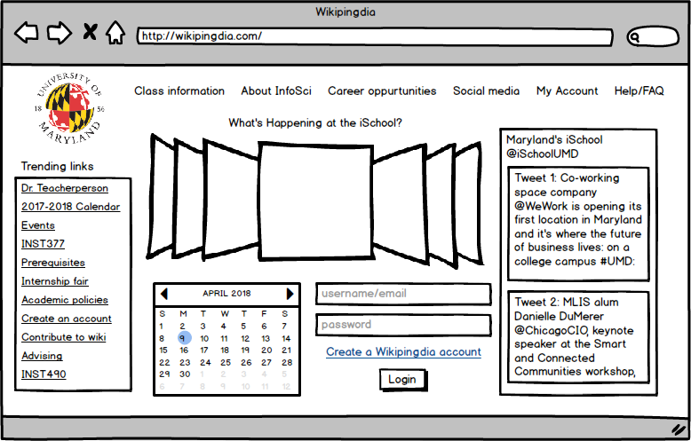

Slide 8
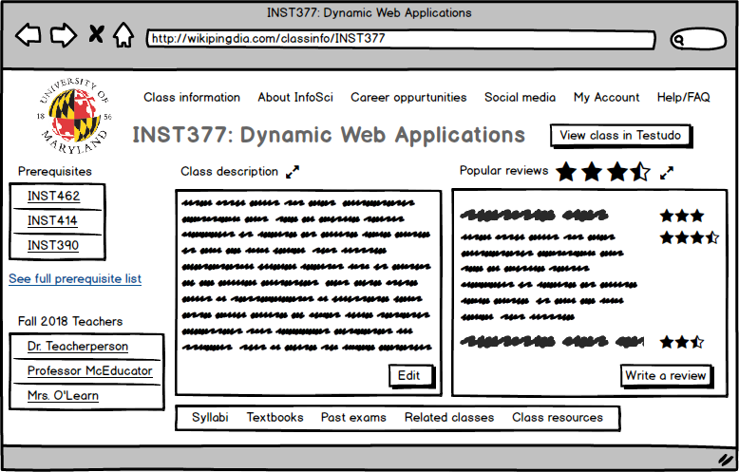

Slide 9
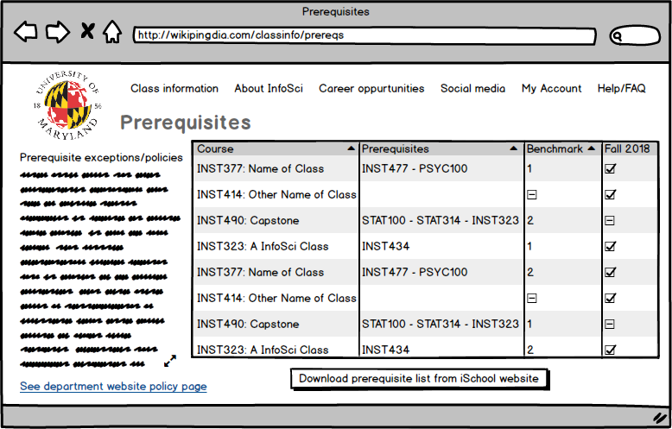

Slide 10
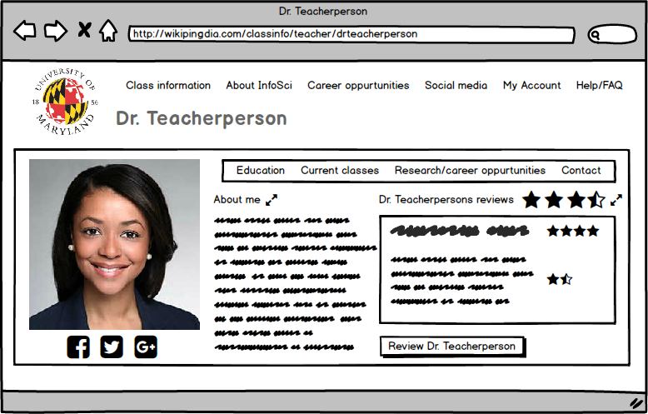

Slide 11
Future plans
Expand our database
Fully implement our additional class resources and useful teacher resources sections
Improve CSS
Add more informational pages
Figure out logistics of departmental approval

Slide 12
Responsibilities
Bryan Bingham: HTML/CSS/Javascript
Paul Pietsch: HTML/CSS/Javascript
Nadine Perez: UX, wireframes, documentation, some HTML
Nick DeWitt: SQL/PHP

